Slide 1
How do wells get recharged?
What is the source of our drinking water?

Slide 2
Vancouver Water
Well water mainly comes from Ground water
40 Wells in 9 Locations
  Some are under ground
  Some are above ground
  Some are water towers
3 Aquifers
  Orchards Upper and Lower
  Troutdale
  Sand and Gravel

Slide 3

Municipal
Wellhead Protection Map
Dark Pink area is < 1 year
Light Pink area is < 5 yrs
Yellow area is < 10 years
What we place on the ground and let sit on the ground matterS!

Slide 4
Chelatchie / Amboy area
Water flows south and west from the ground to the streams
Flows into the Lewis River
Ends up in the Columbia
eNroute the water recharges the near by wells
  Amboy
  Yacolt
  Battleground

Slide 5
Brush Prairie and Vancouver
Water flows from our ground water from the foot hills mostly west
Changes direction towards the south once the water reaches flat land
It takes a long time for water to move often years
Depends on Gravity
  Soil make up
  Gravel and rocks
  Fill and compacted soil

Slide 6
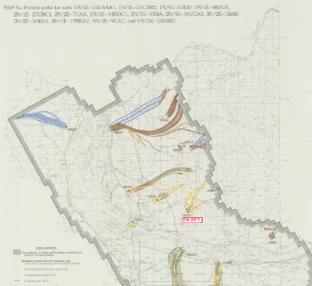
Water Particles tracking map
Map A to the wells

Slide 7

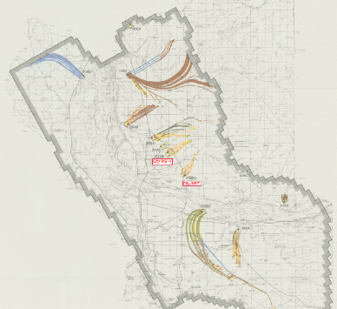
Water Particles tracking
Map b to the wells

Slide 8
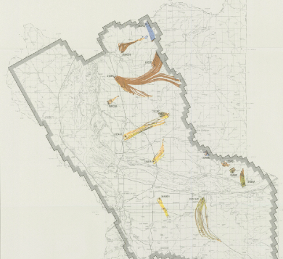
Water Particles Tracking
Map C On the way to the wells

Slide 9
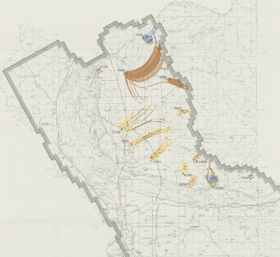
Water Particles Tracking
Map D on the way to the wells

Slide 10
Take Aways
The water flows on the ground, into the ground and through the ground with the help of gravity and time
What we put on the land and into the land will affect our well water in time
Far easier to prevent pollution than to clean up a heavy industrial super fund site

Slide 11
Quote from Chief Seattle, he was a Suquamish and Duwamish Chief
“We don’t inherit the earth from our ancestors, we borrow it from our children.”
Chief Seattle lived circa 1786 – June 1866 (about 80 when he died)
To me the quote rings true when you think about the flow of our water.

Slide 12
Thank you
Resources used for this presentation
  Clark.wa.gov GIS web site
  Wellhead Protection Maps
  Water Supply Paper 2483
    Particle paths from backward particle tracking ; Hinkle, S.R. and Snyder D.T. 1997

